Slide 1

INTERVIEW MANAGEMENT SYSTEM

Slide 2
TEAM MEMBERS
Aravindhan Ra ​
Darshana A​
Deepika S​
Gokul P​
Kumaresh K S​
Prithviraj S P​
Remuki J S​
Sheik Fareeth H​
Vinoth J​
Project Duration in Days : 45 days

Slide 3
ABOUT THIS APPLICATION
​The main purpose of the system is to create drives and to collect the availabilities of the interviewers for that drive.
To conduct large no. of drives instantly and in organized manner.
Also we have provision to create a pool of interviewers to send drive invites.
Utilization of the interviewers can be measured.

Slide 4
EXISTING CHALLENGES​
The time consumed for organizing a drive is high.​
It is difficult to find the availability of an interviewer.​
It is challenging to measure the performance of each interviewer, increase their responsibilities and ownership towards the organization​.

Slide 5
SOLUTION
It is easy to collect the availability of the interviewers for the drive within a particular interval of time.​
It is easy for an interviewer to track their performance.​
It is helpful for a Management person to track his/her performance and it will give and overall picture of their department's performance as well.​

Slide 6
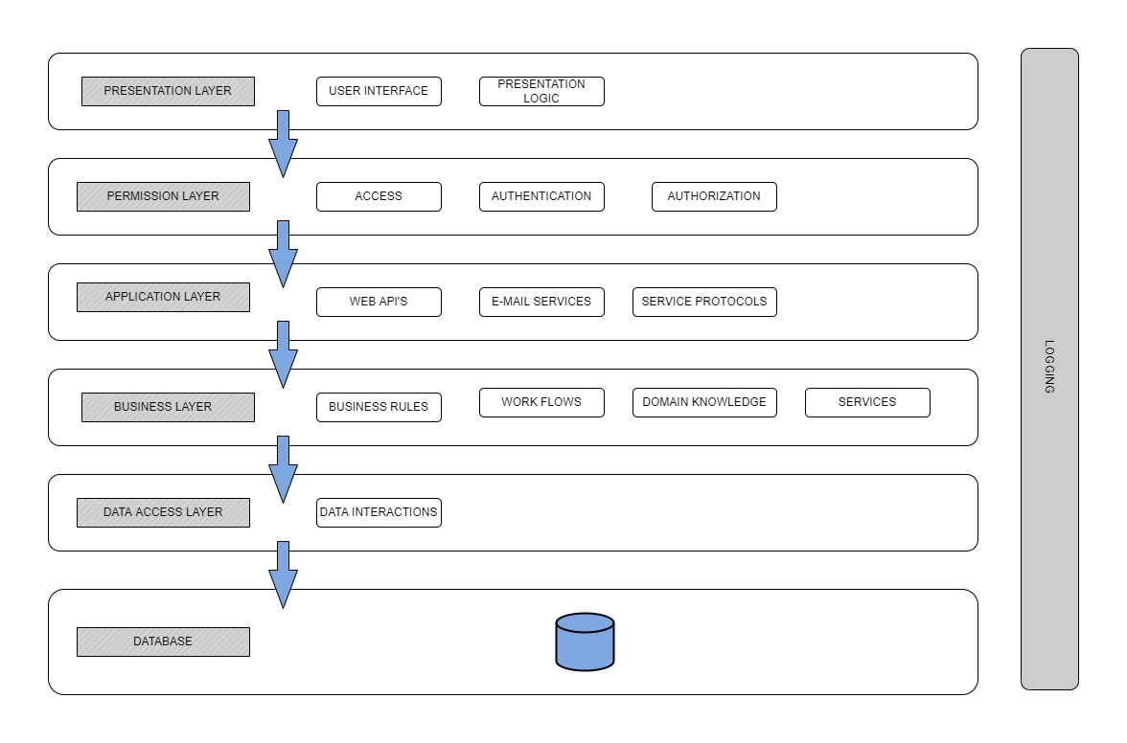
SYSTEM ARCHITECTURE

Slide 7
EXECUTION JOURNEY
Functional and Non-Functional Requirements
User stories​​
Data model
Wireframe​
HTML Template​
High level design
Low level design
Angular Components​
Web API​
Integration​
Unit Testing​
Test scenarios
SonarQube​
JMeter
Linting​
Light House​
Deployment in IIS​
Set-up documentation

Slide 8
ARTIFACTS
Areas​ | Link​
Requirement – User Stories, Wireframes, Data Flow​ | Project/Requirements/Prototype at master · TeamAlpha01/Project (github.com)​
Swagger - API​ | https://localhost:7072/swagger ​
Data Model – EAR (Entity Attribute Relationship)​ | Project/Design/Data Model at master · TeamAlpha01/Project (github.com)​
Test Scenarios​ | ​
Sequence Diagrams​ | Project/Design/Low Level at master · TeamAlpha01/Project (github.com)​
Defect Logs​ | Project/Revised Plan.xlsx at master · TeamAlpha01/Project (github.com)​
Code Quality Metrics​ | Sonar and Lint reports​
Setup Manual​ | Project/Document at master · TeamAlpha01/Project (github.com)​

Slide 9
TECHNOLOGIES & TOOLS USED
Asp Dotnet Core 6.0​
Angular 13​
Visual Studio Code​
Microsoft SQL Server Management Studio
Node js​​
GitHub
Git Desktop
Swagger
SonarQube​
ES Lint
Figma
Jdk​
JMeter​

Slide 10
DEMO
Angular : http://172.24.217.145/IMS-Angular/​
API : ​http://172.24.217.145/

Slide 11
LEASONS LEARNED
Understand the system end to end.​
Collect the requirements properly.​
Think as an end user while designing a system.​
Don't forget to address Non – Functional Requirements.​
Learned to work as a team with responsibilities.​
Always keep a backup of our work.​
To respect others time in our team.​
To avoid conflicts and to resolve conflicts. ​

Slide 12
To value the customer inputs and make use of it.​
To identify the bugs earlier.​
Never assume.​
Learned how to use testing tools.​
Plan with your team before executing new feature.
Don't hesitate to ask questions.​
Team meetings are always important to track the works.​
Brainstorming is very important to share ideas.​
Always update MOM to track the meeting updates.
“Time sheet is the mirror for your career growth.”

Slide 13
THANK YOU ☺

